Slide 1
Object-Oriented Programming Project
Instructors: Le Thanh Son, Nguyen Quang Phu
Topic: LIBRARY MANAGEMENT SYSTEM
Group members:
+ Do Quang Minh – ITITIU19028
+ Nguyen Hoang Linh – ITITIU19023

Slide 2
Overview
2 types of users: Managers and Students
Students: borrow and return books
Manager: manages books, borrowing books of students
18 classes for User Interface.

Slide 3
Back-end
The back-end part contains 6 classes:
+ User (abstract): Store standard information of users
+ Manager (extends User): Store information of each manager
+ Student (extends User): Store information of each student
+ Book: Store information of each book
+ Searching: Manage the output when user search for the name/ID
+ ManageData: Manage the operation of entire system

Slide 4
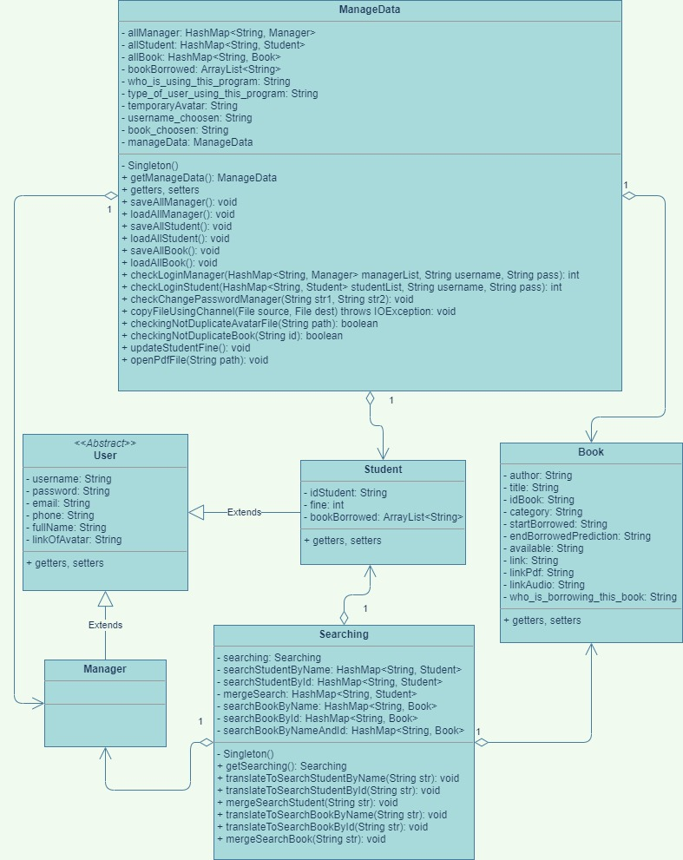
- User: an abstract class
- Student and Manager extend User
- Searching and ManageData use many non-primitive data types: Manager, Student, Book
- Searching + ManageData are used for manage the operation of the system so they need so many methods.

Slide 5
Some methods of class Searching:
Name of method | Function
getSearching(): Searching | Get instance of “Searching” through Singleton
translateToSearchStudentByName(String str): void | Search for student by name
translateToSearchStudentById(String str): void | Search for student by ID
mergeSearchStudent(String str): void | Search for student by name and ID
translateToSearchBookByName(String str): void | Search for book by name
translateToSearchBookById(String str): void | Search for book by ID
mergeSearchBook(String str): void | Search for book by name and ID

Slide 6
Some methods of class ManageData:
Name of method | Function
getManageData(): ManageData | Get instance of “ManageData” through Singleton
saveAllManager(): void | Save the data of managers
loadAllManager(): void | Load the data of managers
saveAllStudent(): void | Save the data of students
loadAllStudent(): void | Load the data of students
saveAllBook(): void | Save the data of books
loadAllBook(): void | Load the data of books

Slide 7
Some methods of class ManageData:
Name of method | Function
checkLoginManager(HashMap<String, Manager> managerList, String username, String pass): int | Check if manager type right password
checkLoginStudent(HashMap<String, Student> studentList, String username, String pass): int | Check if student type right password
copyFileUsingChannel(File source, File dest) throws IOException: void | Use for copy the files to the safe place
checkingNotDuplicateAvatarFile(String path): boolean | Checking if someone’s avatar is the same of the current account
checkingNotDuplicateBook(String id): boolean | Checking if the ID of a book is existed
updateStudentFine(): void | Change student’s fine if their borrowing book is overdue
openPdfFile(String path): void | Open the pdf file of the E-book

Slide 8
Thank You!

